Slide 1

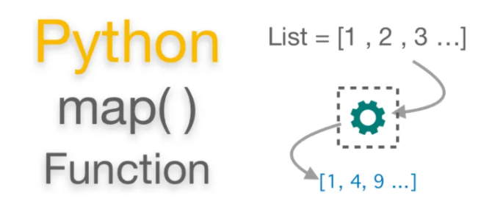
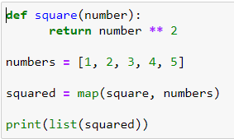
Map
What is map()
● It is a built-in function that allows you to process and transform all the items in an iterable without using an explicit for loop.
● map() is useful when you need to apply a transformation function to each item in an iterable and transform them into a new iterable.
Syntax
map(function, iterable[, iterable1, iterable2,..., iterableN])
How does it work
● map() applies function to each item in iterable in a loop and returns a new iterator that yields transformed items on demand.
●This first argument to map() is a transformation function.

